Slide 1

COLLABORATIVE FILTERING
RECOMMENDATION SYSTEM
Presented by:
K Pranay Venkata Sai 2023003061
Guide :
Mrs V. Satya Aruna
Assistant Professor

Slide 2

ABSTRACT
E-commerce platforms produce vast user interaction data with complex and sparse patterns. This project addresses the limitations of rule-based and popularity-based methods by implementing a collaborative filtering model using SVD and KNN to capture latent user-item relationships. The system supports real-time predictions, evaluates performance using RMSE, MAE, Precision, and Recall. Results show strong personalization capabilities and improved user engagement.

Slide 3
1. INTRODUCTION, PROBLEM & STATISTIC DOMAIN
E-commerce platforms like Amazon have transformed digital shopping by offering vast product selections. However, this abundance often overwhelms users, making it difficult to discover relevant products. Machine learning–driven automation, particularly collaborative filtering, can uncover personalized patterns from user-item interactions.
Problem Statement:
Manual browsing is time-consuming, generic, and fails to adapt to individual preferences. Traditional recommendation methods are either too rigid or cannot capture complex user behavior trends.
References: Ricci et al., 2015 – Collaborative filtering foundations; Aggarwal, 2016 – Matrix factorization and similarity metrics; Koren et al., 2009 – SVD in recommendation systems.
Statistics: Amazon hosts millions of products; over 35% of purchases are driven by recommender systems; studies show users are 70% more likely to engage with personalized suggestions.

Slide 4
2. LITERATURE REVIEW
Authors | Titles | Dataset | Results
Chen R., Hua Q., Chang Y.-S., Wang B., Zhang L., Kong X. (2018) | A Survey of Collaborative Filtering-Based Recommender Systems: | Epinions, Tencent, Flixster | Comprehensive survey highlighting the evolution of collaborative filtering methods, emphasizing the integration of social network data to address challenges like data sparsity and cold-start problems.
Zhang R., Liu Q., Gui C., Wei J., Ma H. | Collaborative Filtering for Recommender Systems | Not specified | Proposed enhancements to traditional collaborative filtering algorithms, focusing on improving recommendation accuracy and system scalability.
Koren Y., Bell R., Volinsky C. (2009) | SVD++: A Scalable Collaborative Filtering Approach | Netflix Prize Dataset | Introduced the SVD++ algorithm, incorporating implicit feedback into matrix factorization, which significantly enhanced recommendation accuracy in large-scale systems.
Thannimalai V., Zhang L. | A Content-Based and Collaborative Filtering Recommender System | Not specified | Designed a hybrid recommender system combining content-based and collaborative filtering techniques, leading to improved personalization and recommendation diversity

Slide 5
3. GAPS IDENTIFIED FROM LITERATURE REVIEWS
Most studies focus on model development and accuracy but lack end-to-end system deployment, especially real-time recommendation interfaces for users.
While some papers mention data sparsity, only a few provide practical solutions for cold start users or items, especially in large-scale e-commerce datasets.
Most models treat user preferences as static; very few incorporate time-aware or context-aware mechanisms to track evolving user behavior.
Despite the proven effectiveness of combining content-based and collaborative filtering, hybrid models are rarely implemented or evaluated in depth across real-world datasets.
Studies like those using MapReduce (Shen et al.) prioritize scalability but may compromise recommendation precision, while others optimize accuracy on smaller datasets without proving scalability.

Slide 6
4. PROPOSED PROBLEM: DATASET & STATS
Built a collaborative filtering model using SVD + KNN to recommend personalized products based on user-item interactions.
Dataset:
Source: Amazon Electronics Reviews (via Kaggle)
Duration: Collected over several years of platform usage.
Fields: userId, productId, rating, timestamp
Key Stats:
1.5M+ user-product interactions (sampled)
Avg rating: ~4.0
Model trained on user-item matrix filtered for ≥50 interactions per item using Surprise library

Slide 7
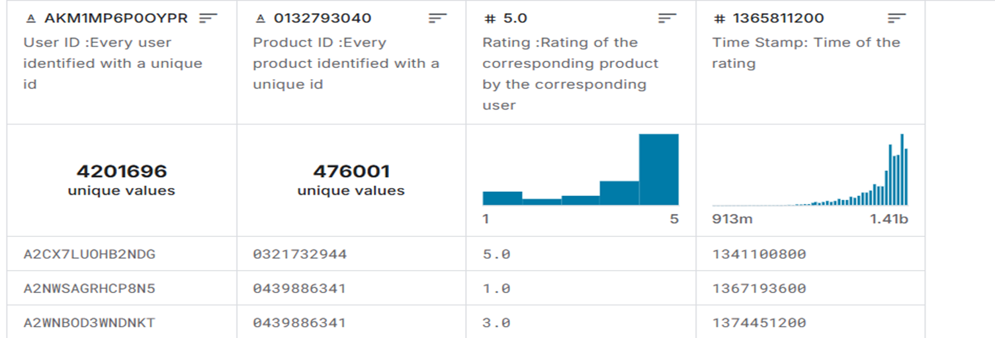
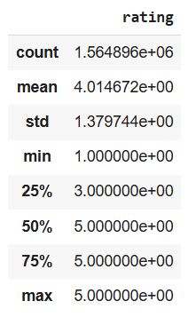
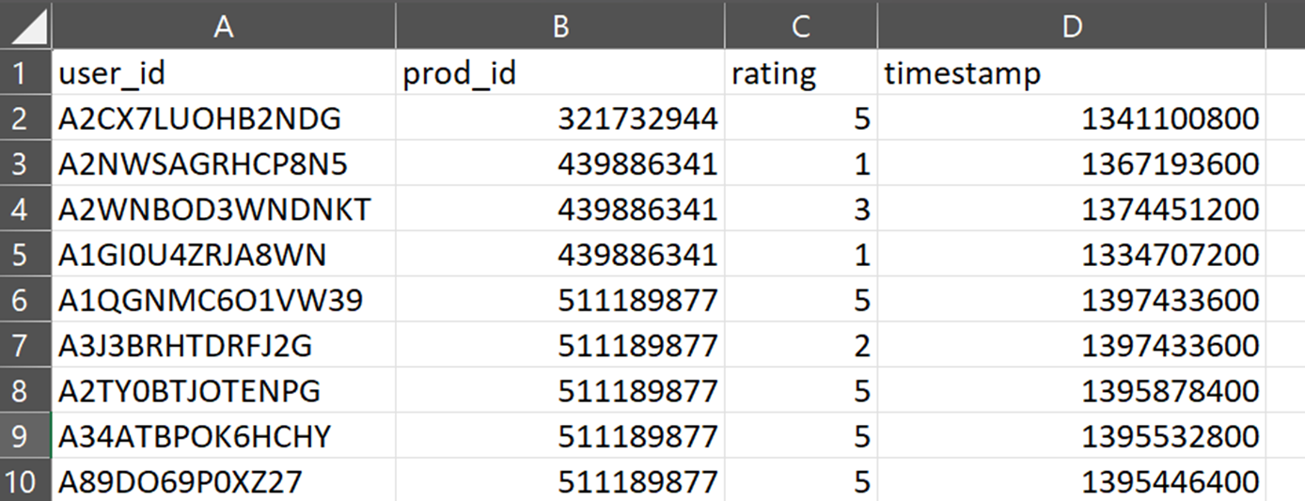
Dataset Overview:
Dataset: Data Summary

Slide 8
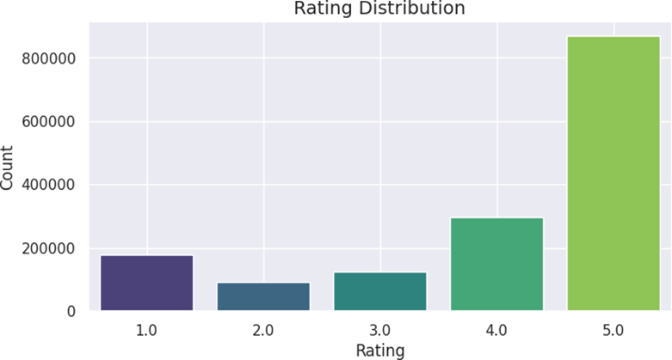
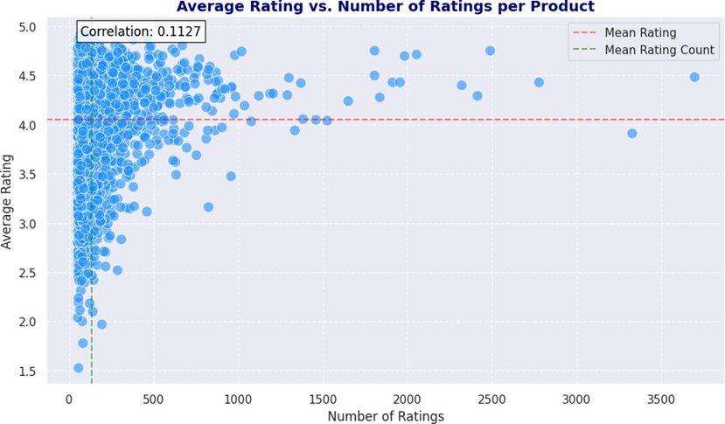
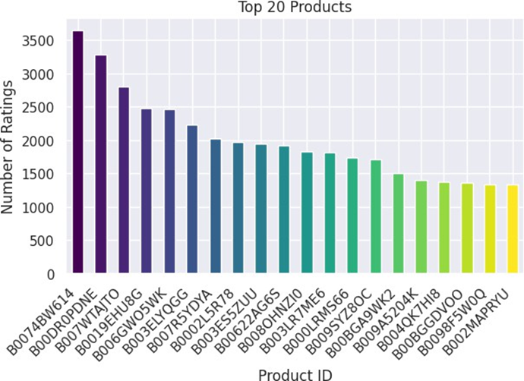
5. DESCRIPTIVE ANALYTICS
Correlation btw Rating count and Average rating

Slide 9
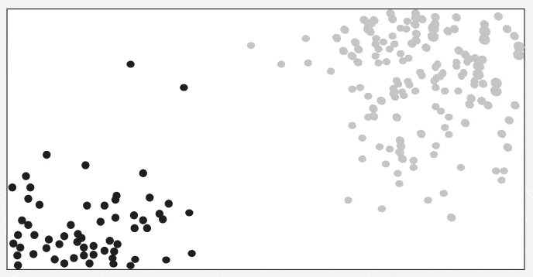
6. MODELS PROPOSED
6.1 KNN Algorithm
The KNN (K-Nearest Neighbors with Means) model was implemented as a memory-based collaborative filtering approach using the Surprise library. Specifically, it used item-item similarity (not user-based) with Pearson correlation to identify relationships between products based on user ratings . The model was trained using the KNNWithMeans algorithm and used the predict() function to estimate how a user would rate unseen items. This allowed the system to recommend products that are similar to those already rated positively by users, effectively providing similar product recommendations .
Working of KNN Algorithm

Slide 10
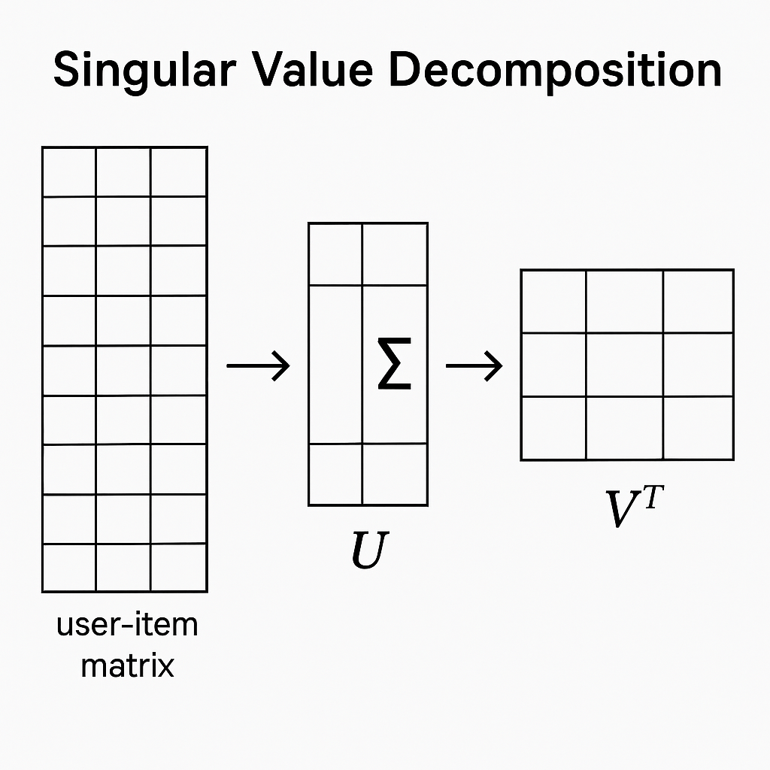
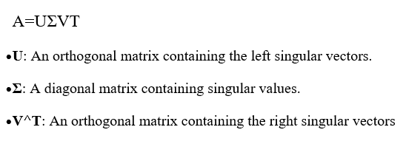
6.2 Singular Value Decomposition (SVD)
The SVD (Singular Value Decomposition) model was implemented as a model-based collaborative filtering technique using the Surprise library. It was trained on a filtered Amazon Electronics dataset to learn latent user and item features from rating data. The predict() function was used to estimate ratings for unseen user-product pairs, enabling personalized Top-N product recommendations. Additionally, hyperparameter tuning was performed using RandomizedsearchCV to optimize model performance

Slide 11
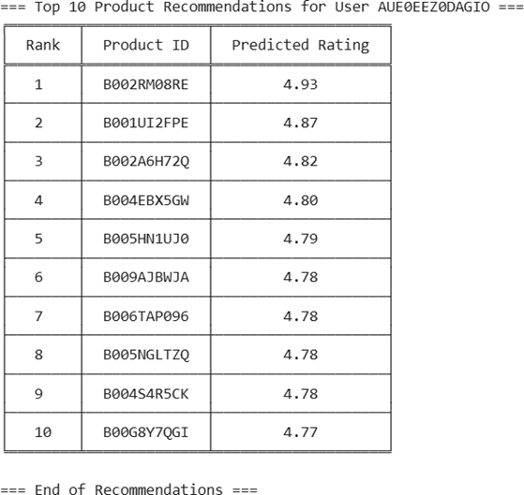
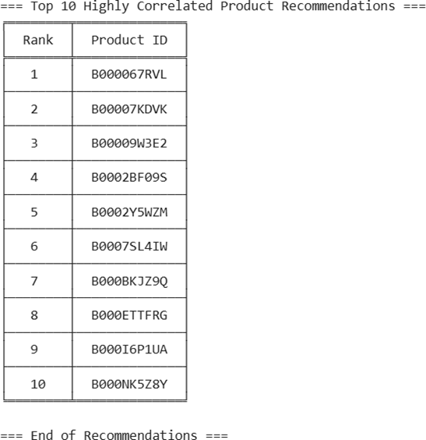
7. RESULT & DISCUSSION
The results screenshots display the system's ability to generate personalized product recommendations using collaborative filtering models. One image shows Top-N recommended items for a specific user based on predicted ratings. The other highlights similar products suggested for a given item, demonstrating item-item collaborative filtering effectiveness.

Slide 12
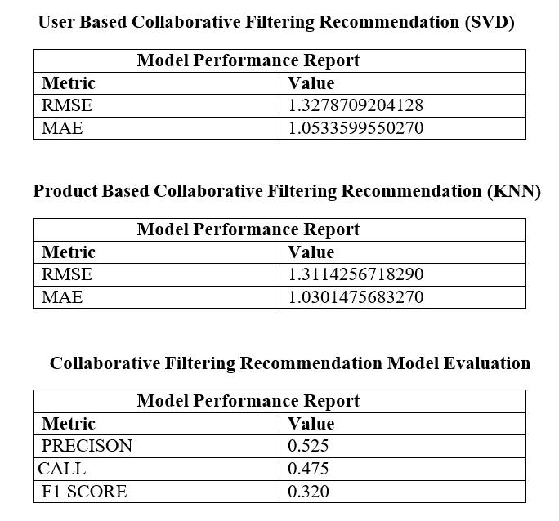
Key Performance Metrics

Slide 13
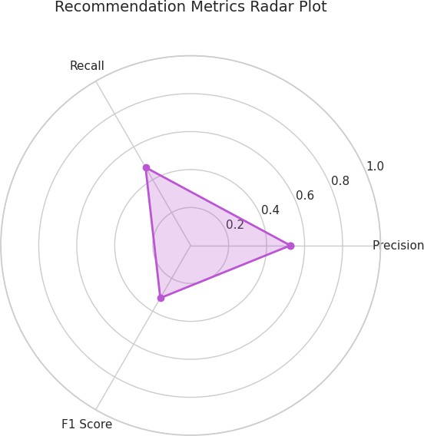
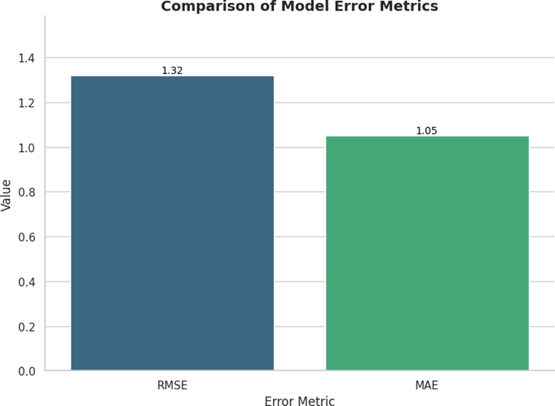
8. Model Error Metrics Visualization
The radar plot and bar plot provide a visual comparison of the model’s performance across
key error metrics such as RMSE, MAE, and F1-Score. The radar chart highlights the relative strengths and
weaknesses of each metric, while the bar plot clearly quantifies their exact values.
Together, they validate the effectiveness of the collaborative filtering models used in the system.
Bar plot of Model Error Metrics
Radar Plot of Model Metrics

Slide 14
9. CONCLUSION & FUTURE SCOPE
This project focused on implementing Collaborative Filtering techniques, using Singular Value Decomposition (SVD) and K-Nearest Neighbors (KNN), to build a personalized recommendation engine. The model achieved strong predictive performance with RMSE of ~1.31 and provided relevant product suggestions, demonstrating the effectiveness of collaborative filtering in identifying user preferences in large, sparse datasets. Despite limitations like the cold start problem, the system successfully recommended high-interest items to users based on historical interactions.
Implement Hybrid Models: Combine collaborative and content-based filtering to handle cold start and improve recommendation diversity.
Add Temporal & Context Awareness: Use time-aware models (e.g., TimeSVD++) and user context to adapt to changing preferences over time.
Real-Time Deployment & Scalability : Develop a full-stack web or mobile app for real-time recommendations and scale it using cloud-based solutions.

Slide 15
10. REFERENCES
A survey of collaborative filtering-based recommender systems: From traditional methods to hybrid methods based on social networks. Chen et al., 2018 Chen R., Hua Q., Chang Y.- S., Wang B., Zhang L., Kong X.
A new method to find neighbor users that improves the performance of collaborative filtering. Expert Systems with Applications, 83 (2021), pp. 30-39. Koohi and Kiani, 2021
Collaborative filtering-based recommendation system for big data. International Journal of Computational Science and Engineering, 21 (2) (2020), pp. 219-225. Shen et al., 2020 . Shen J., Zhou T., Chen L
Collaborative Filtering for Recommender Systems. Ruisheng Zhang; Qi-dong Liu; Chun- Gui; Jia-Xuan Wei; Huiyi-Ma.
A Content Based and Collaborative Filtering Recommender System. Vignesh Thannimalai; Li Zhang. https://ieeexplore.ieee.org/document/9737238
SVD++: A Scalable Collaborative Filtering Approach Koren, Y., Bell, R., & Volinsky, C. (2009). IEEE Computer Society Research on matrix factorization models like SVD, widely used in recommendation systems.

Slide 16

THANK YOU

